Slide 1
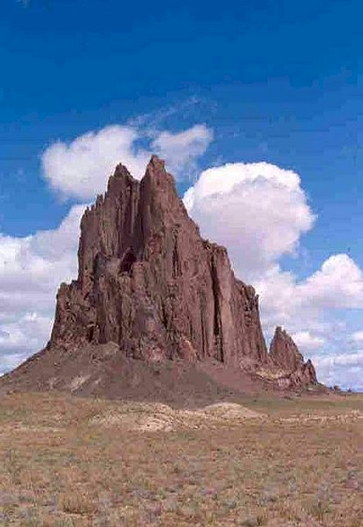
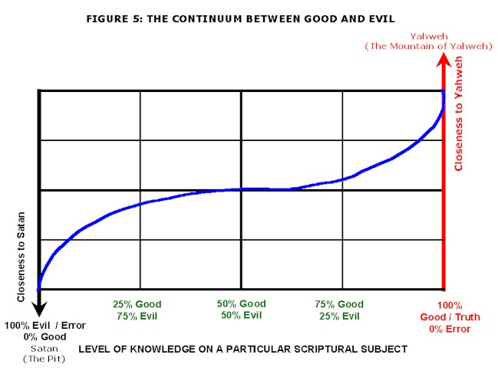
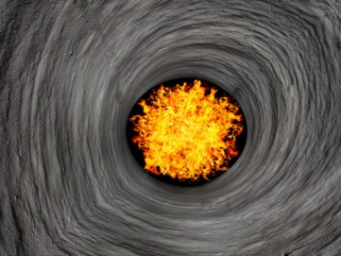
Turning history on its head
Massive evidence of a global flood
What does it all mean?
Part 11 – End notes
Some important information
The mountain of ALL truth
End Time Issue Ministries
Dr James A Robertson PrEng
Notes:
Image of the document?
Create a book cover for it?
See if can have a link in the video to the document on disk?
Or just Northcliff again?

Slide 2
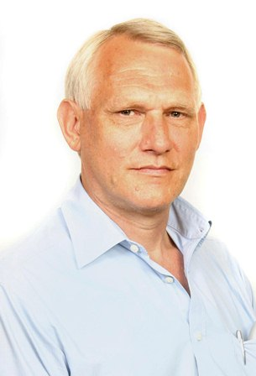
Wrapping up
What follows is, in my opinion, the most important information on this entire DVD
It does not help to accept that there was a flood if one does not come to repentance and seek a deep relationship with our Father in Heaven
It is difficult to have a deep relationship with Him if we do not know the basics about Him
This section seeks to present some critical information which I hope you will find of value

Slide 3
Seek truth NOT error
Our world is full of error, do not get stuck on it
I have error I do not know about, do not get stuck on what you think I have in error
Seek the truth the Almighty Creator, Yah the eternally self existing, has for you today
When you meet people, focus on the truth they have that you lack and share the truth you think you have
Do not get into arguments, share what you hold to be truth and gather what another may have that is truth and then, if you cannot agree, move on
There are many lost truths, those I think are most important are summarized here
Words in curly brackets are words that are widely used but which I understand to be incorrect

Slide 4
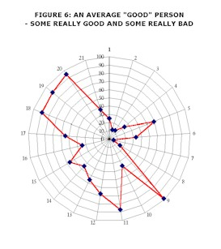
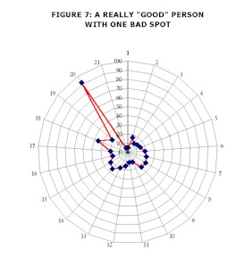
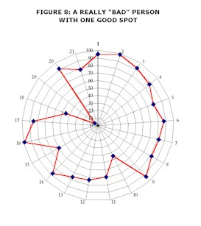
Seek truth NOT error Examples of error in different people
Most people have a mixture of truth and error
The person in the middle probably does not exist today

Slide 5
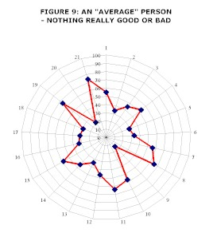
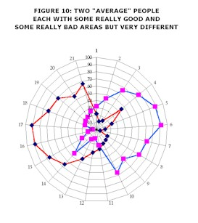
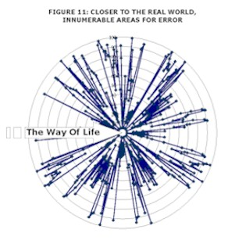
Seek truth NOT error Examples of error in different people
The two in the middle both have a lot of truth and a lot of error but will disagree on almost everything
Most people are a complex mixture of truth and error as on the right

Slide 6
Confusion regarding names, terms, beliefs – Yah the eternally self existing
Major errors and confusion relating to names
True name of the Creator is “Yah”
His most widely used name is “Yah the eternally self existing”
Frequently translated as Yahweh or Yahooeh
His name is NOT “THE LORD” which is a literal translation of “Baal” which is a pagan name
“THE LORD” is therefore blasphemous and should be avoided

Slide 7
Confusion regarding names, terms, beliefs – Yahooshua – Yah is salvation
The man commonly referred to as “Jesus” was a Hebrew
He was not a Greek
Jesus is a derivative of the Greek word Iesus which in turn is derived from Zeus which is the name of a pagan deity and is therefore blasphemous
Avoid the use of Jesus at all times
His true name was Yahooshua which means “Yah is salvation”
This is the message which he came to bring and he should always be referred to by this name “Yahooshua”
It is an insult and disrespectful to call the most powerful human being in existence who is king of all human kings and lord of all human lords by anything other than his correct name

Slide 8
Confusion regarding names, terms, beliefs
God is a pagan name and therefore blasphemous
The word translated “God” or “god” means “Mighty One” or “Almighty” when applied to the Creator or “mighty one” when applied to anyone else
A ruler or judge is a “mighty one” and can therefore technically be referred to as a “god” but in actual fact the word god should not be used at all
Except perhaps for Satan in the sense of “god (mighty one) of this world”
Yahooshua {Jesus} is a might one and therefore can technically be called a god but it is disrespectful to do so
This duality of meaning gives rise to confusion

Slide 9
Confusion regarding names, terms, beliefs – Christ is NOT a name
The word “Christ” derives from the Greek “Christos”
It is used as a substitute for a technical term which refers to the impartation of the Spirit of the Almighty in a form of “smearing” that is called “anointing”
Thus “Jesus Christ” means “Yahooshua the anointed of Yah”
“Christ Jesus” means “the anointing of the Spirit of Yah that was upon Yahooshua”
“Christ” means “anointed one” or “the anointed of Yah”
“Christ” is NOT Yahooshua’s name
Any believer filled with the Spirit of Yah is an anointed one, that is a “christ”
It is confusing and disrespectful to call Yahooshua “Christ” rather refer to him by his correct name “Yahooshua the anointed of Yah” or simply “Yahooshua”

Slide 10
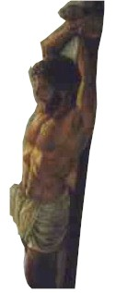
Confusion regarding names, terms, beliefs – some more word errors
Yahooshua was executed on a stake (a length of tree trunk) NOT a cross
The cross is a pagan symbol that has pornographic symbolism and should be avoided
The word “holy” actually means “set apart” and relates to separation from the things of the world
“Bible” is derived from the Greek “Biblios” which means book as in the Afrikaans “Biblioteek” meaning library
The book does not claim a title for itself, it is merely a compendium of writings and different compendia appropriate the title “Bible” – the word should be avoided
All versions of the book contain error and none claim to be without error or fully inspired
There are texts in the book which are inspired by Yah and recorded with varying levels of accuracy
It IS an important reference work

Slide 11
Confusion regarding names, terms, beliefs – more confusing words
“Baptise” is another confusing term which should be correctly translated “immerse”
It refers to full immersion in water and is a routine procedure for cleansing that is laid down repeatedly in Leviticus
It is not mechanically possible to immerse a person with a thumb dipped in a cup of water and therefore the debate about what constitutes baptism is eliminated, immersion is the prescribed ordinance of full immersion
We should immerse regularly
“Angel” is a representation of a word that means “messenger”, it is more helpful to refer to them as messengers because that is what they are

Slide 12
Confusion regarding names, terms, beliefs – confusion around marriage
Marriage means “sexual intercourse with a virgin, widow or truly divorced female”
In Yah’s terms the joining of a man and female in some ceremony is invalid and is adultery unless the woman satisfies one of the above conditions

Slide 13
Covenant includes a death penalty
Covenant includes a death penalty
Father Yah has made numerous covenants with human beings, starting with Adam and thereafter with Noah, Abraham, Isaac, Jacob, David, Yahooshua, etc and with many others
He still makes covenants today
Failure to observe a covenant leads to death, it may result in premature death in this life failing which it will lead to eternal death
Thus while much is made of the covenant through Yahooshua it should be seen in context and it must be understood that wilfully and repeatedly breaking that covenant will lead to eternal hell fire -- Hebrews 6:4-6
Notes:
The symbolism of the covenant with blood speaks of death for covenant breaking
There IS repentance BUT there is a point at which eternal death and possibly physical death results
The taking of virginity gives rise to an unbreakable blood covenant and death for adultery
The covenant at Sinai is coupled to eternal death if break the ten laws {commandments}
The covenant by and through Yahooshua ALSO includes a death penalty – Hebrews 10

Slide 14
Judgment in this life
There IS judgment in this life
We may request judgment in this life in order that we are not judged in the life to come
We will be judged in any event – any illness, accident, loss of any sort is a judgment
Judgment requires the prosecutor – Satan or one of his messengers to bring charges before the Court of Heaven
Yahooshua as our advocate pleads for mitigation of sentence, mercy, etc as may be applicable
Father Yah as the Judge hands down the sentence
Satan and his messengers and demons execute / carry out the sentence, for example by causing an accident
Notes:
There is judgment in THIS life
AND
There WILL be a Day of Judgment in which Yahooshua will return and call us all to be judged and separate those who will burn for eternity from those who will spend eternity in the place we call heaven but even there there IS outer darkness
There IS repentance and forgiveness BUT wilful sin results in death
It IS possible to overcome to the end and sit on a high throne with Yahooshua
Revelation 21:7 and 8??

Slide 15
Judgment in this life
Judgment in this life is to be sought and desired
It trains us, allows us to learn
It is GRACE that helps us to learn and avoid damnation in the life to come and if we desire it helps us to aspire to a high throne for eternity
Allows us to pay the price for our sin in this life and therefore helps us to avoid a part in the lake of fire for eternity
Pray “Father I ask you to judge me severely and correct me harshly that I may serve you more perfectly”
Notes:
There is judgment in THIS life
AND
There WILL be a Day of Judgment in which Yahooshua will return and call us all to be judged and separate those who will burn for eternity from those who will spend eternity in the place we call heaven but even there there IS outer darkness
There IS repentance and forgiveness BUT wilful sin results in death
It IS possible to overcome to the end and sit on a high throne with Yahooshua
Revelation 21:7 and 8??

Slide 16
The spiritual journey of man on earth over seven thousand years
At the start (6,000 + years ago) human beings ONLY knew good
As a consequence of disobedience and rebellion they started to learn all there is to learn about evil
This generation, 6,000 years from the creation of mankind, is the most evil generation that has ever lived
Yahooshua came and died that we might regain authority on earth
We are called to restore good on earth in order that he may return
At present Yahooshua, having been resurrected because he lived a life without sin, is “seated at the Right Hand of the Father WAITING for his enemies to be made his footstool”: Matthew 22:44, Mark 12:36, Luke 20:43, Acts 2:35, Hebrews 1:13 and Hebrews 10:13
Notes:
This could be the most important decision you ever make
Please give it serious consideration
Consider also that if there can be such great error that flies in the face of such “in your face” evidence of a global flood as we have looked at in this presentation, how much more likely is it that there can be error in all sorts of other areas of teaching

Slide 17
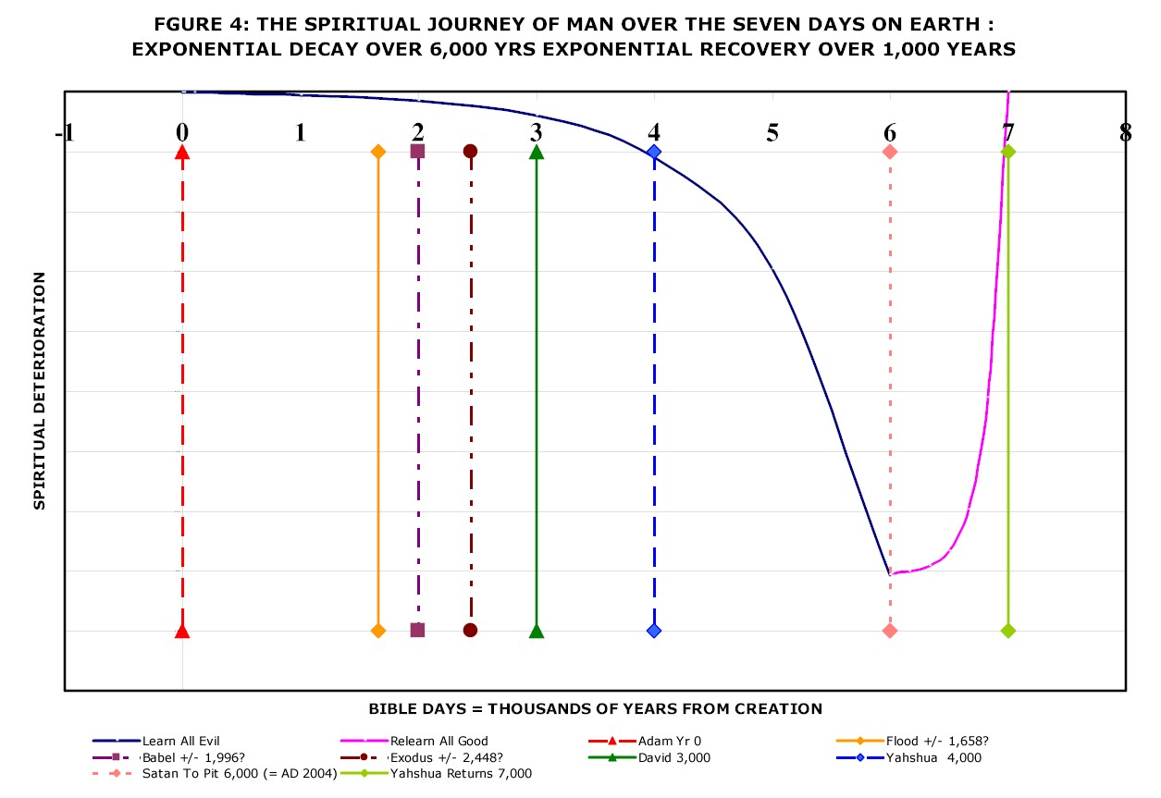
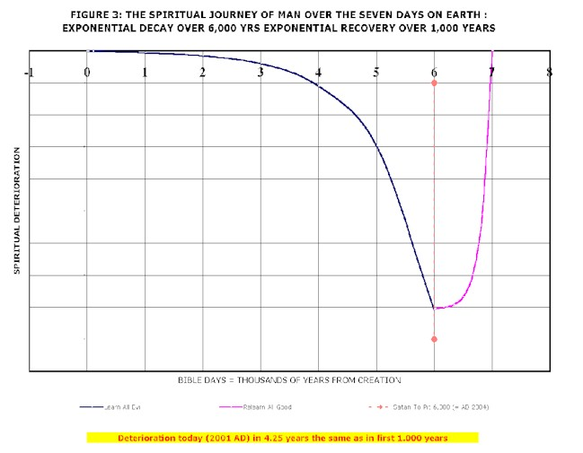
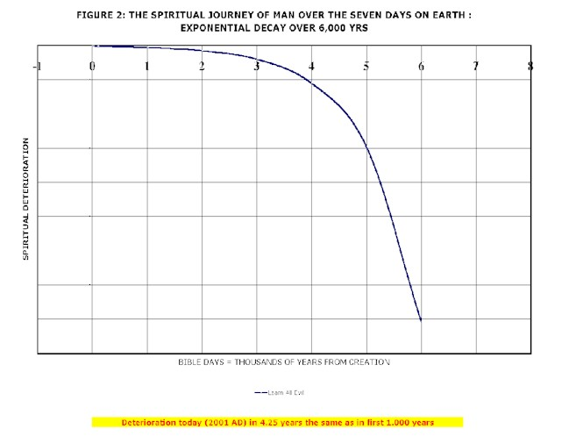
The spiritual journey of man on earth over seven thousand years
Judgment
Flood
Yahooshua
Today
Notes:
This could be the most important decision you ever make
Please give it serious consideration
Consider also that if there can be such great error that flies in the face of such “in your face” evidence of a global flood as we have looked at in this presentation, how much more likely is it that there can be error in all sorts of other areas of teaching

Slide 18
The spiritual journey of man on earth over seven thousand years
Satan was cast into the Pit for one thousand years in 2003
2,000 years ago, Yahooshua, having regained authority on earth from Satan by living a sinless life, immediately handed that authority to those that followed him and went to sit at the right hand of Father Yah to AWAIT the time when his followers would regain authority on earth and prepare a place for his return
That is not happening because believers do not understand that it is their role to prepare for Yahooshua, they mostly believe that “Jesus is coming soon” and are sitting back waiting for Yahooshua to sort out the mess
Yahooshua is waiting for us to sort out the mess – we have less than a thousand years in which to do this – some say much less time – be prepared no matter the hour or day
If we truly understood the significance of Yahooshua’s return, the onset of judgment, we would NOT be asking for his soon return
Notes:
This could be the most important decision you ever make
Please give it serious consideration
Consider also that if there can be such great error that flies in the face of such “in your face” evidence of a global flood as we have looked at in this presentation, how much more likely is it that there can be error in all sorts of other areas of teaching

Slide 19
The continuum between the mountain of Yah and the Pit
This life and the life to come are more complex than most understand
There is a continuum between entirely and completely good which has only been achieved by Yahooshua and Father Yah and entirely and completely bad which has only been achieved by Satan
The climb to all good is metaphorically referred to as “the mountain of Yah” whereas the slippery descent to all evil is the Pit, where Satan is currently imprisoned
IF the believers are successful in preparing a place for Yahooshua to return to then Yahooshua will return to receive his kingdom and Satan, his messengers and all those who have not qualified to enter heaven will be cast into the lake of fire
If they do NOT succeed then Yahooshua will never return and Satan will take control of the earth for ever
Notes:
Graph of Pit to Mountain

Slide 20
Climbing the mountain of the Almighty The continuum between all truth and all evil
The mountain of ALL truth
The pit of ALL error
Notes:
This could be the most important decision you ever make
Please give it serious consideration
Consider also that if there can be such great error that flies in the face of such “in your face” evidence of a global flood as we have looked at in this presentation, how much more likely is it that there can be error in all sorts of other areas of teaching

Slide 21
The continuum between the mountain of Yah and the Pit
Most people are luke warm, they are on the gently sloping ground in the middle between serving Yah and serving Satan
Most are oblivious to the battle that is raging all around them in the spiritual realm and are oblivious to the fact that in the absence of concerted action to climb the mountain of Yah they will eventually slide into the Pit or be cast into the lake of fire on the Day of Judgment
Climbing the mountain requires constant focussed effort so, if you are not consciously seeking to climb the mountain you are almost certainly sliding away and towards the Pit
Notes:
Graph of Pit to Mountain

Slide 22
Yah is one, have NO OTHER mighty ones
Yahooshua stated in Mark 12:29-30 "The first of all the commandments is: 'Hear, O Israel, Yah the eternally self existing our Mighty One, Yah the eternally self existing is one. And you shall love Yah the eternally self existing your Mighty One with all your heart, with all your soul, with all your mind, and with all your strength.' This is the first commandment.”
In Exodus 20:3 it is written that Yah said on the mountain “You shall have no other mighty ones before Me.”
It is therefore clear that it is sin to equate Yahooshua to Yah or to worship Yahooshua or in any way conjoin Yahooshua to Yah in the way that is customarily done
Notes:
Yahooshua is NOT Yah
It is sin to equate Yahooshua with Yah or to worship him as Yah
There is NO trinity, the set apart Spirit IS Yah and it is the Spirit of Yah on a person that makes them “Christ” including Yahooshua
All who truly believe and call on the Name of Yah for salvation, that is call on Yah’s shua (Yah’s salvation) will be saved
All who are anointed (i.e. “christ”) have the potential to do GREATER works than Yahooshua

Slide 23
The Ten Laws
The Ten Commandments, that is the ten laws, which are the sole contents of the Container {Ark} of the Covenant are the essence of the Covenant made by the Almighty at Sinai
Since Yah appeared in fire on top of the mountain and spoke with an audible voice to several million people we must assume that these are the most important words ever spoken to human beings since this is the only time He has appeared so concretely that we know of
The ten laws will form the basis of judgment
Notes:
Ten laws – lift out the headlines from the document
Image from Jonathan
Talk briefly to those not dealt with elsewhere here

Slide 24
The Ten Laws
The ten laws can be summarized as:
1. Yah is one -- have no other mighty ones before him, includes do NOT worship Yahooshua
2. No graven images or idols, includes do not worship the bible
3. Do not use the name of Yah in vain, includes not using God, the LORD, etc
4. Observe the true Sabbath (Saturday) and feasts and fasts
Notes:
Ten laws – lift out the headlines from the document
Image from Jonathan
Talk briefly to those not dealt with elsewhere here

Slide 25
The Ten Laws
5. Honour your mother and father
6. Do not commit murder, includes do not oppose the death penalty, do not curse, no abortion, no contraception that causes abortion
7. Do not commit adultery, based on virginity and widowhood as set out above
8. Do not steal
9. Do not bear false witness, includes lying
10. Do not covet, includes lust
Notes:
Ten laws – lift out the headlines from the document
Image from Jonathan
Talk briefly to those not dealt with elsewhere here

Slide 26
How did Yahooshua become King and achieve what he did?
100% human being
Born with a creative miracle less dramatic than Adam and Eve
No human father therefore no blood line curses
First created spirit, lived with Yah before coming to earth so knew Yah well and Yah’s ways and Satan’s ways so well equipped
Lived a life without sin, gained victory and regained authority over the heavens and the earth
King because humans proclaimed him king
Lord (Adonai) because humans proclaimed him lord
Notes:
Bullets from the document
ALL the result of inspired prophetic words and actions NOT magic

Slide 27
How did Yahooshua become King and achieve what he did?
Lamb of Yah because Yahoochanan {John the baptist} proclaimed him the Lamb
Through that assignment gained the right to take the place of the animal offerings for sin and thus provide a simpler way to forgiveness
Assigned the body and blood of the lamb to the bread and wine at the last meal with those who followed him most closely thereby assigning the body and blood of the lamb to bread and wine so that all believers anywhere had access to the mechanical ingredients necessary for forgiveness of sin by FAITH
Became high priest because the High Priest laid hands on him in mockery and proclaimed him Messiah and the blood of the offering fell on the Mercy Seat of the Ark of the Covenant
Became offering for atonement because his blood fell on the Mercy Seat, also the people laid hands on him for transfer of sin and sent him outside the gate and took his blood on themselves
Notes:
Bullets from the document
ALL the result of inspired prophetic words and actions NOT magic

Slide 28
How did Yahooshua become King and achieve what he did?
There is nothing magical about what Yahooshua achieved
Not even anything particularly supernatural
He lived a life without sin, THAT is the most noteworthy achievement and he died without sinning and as a consequence death had no hold on him and he was automatically resurrected
Death in this life is the price we pay for sin, if we live without sin we are entitled to be resurrected, thus far only Yahooshua has accomplished this and so the position of King of Kings and Lord of Lords is filled for eternity
But, through Yahooshua’s life and death we have access to repentance and therefore to eternal life
Notes:
Bullets from the document
ALL the result of inspired prophetic words and actions NOT magic

Slide 29
The beast? The mark? The Pit?
The beast is another name of Satan or one of his principalities
The mark of the beast is a spiritual mark in the forehead – what we think and in the hand – what we write and contract
The Pit is a prison into which offending spirits are sent until their period of sentence has been served
Notes:
What is the beast?
Error and deception, all who serve error and who sin, whether knowingly or unknowingly – ALL LIARS will burn
The mark – break ten laws and disobey Yah in what think and contract and by extension speak and write
It is my understanding that Satan is in the Pit for one thousand years

Slide 30
The other Sabbaths
In addition to the Saturday Sabbath we are required to observe:
Passover
The feast of unleavened bread
Pentecost
The Feast of Trumpets
The Day of Atonement a set apart {sacred} fast day – total fast
The Feast of Tabernacles in particular the first and the eighth (Great) Day
Notes:
Other sheepfolds
Mayan Indians? – questo coottle – look for name on Internet
Others
Muhammed was a prophet, Muslims are seeking to serve Yah and are more righteous than most and are offended by obvious errors of Christians and Yahoodites {Jews}
Error in different religions separates instead of seeking the truths that others have
Yahoodites {Jews} are ALSO seeking to serve Yah in their own way and are offended by obvious errors of Christians and Muslims

Slide 31
Other important points -- Islam
Muhammed is also a prophet of the Most High and the Muslims are people of Yah, Allah is the Arabic word that corresponds to Elohim, the Hebrew Word for the Almighty
Muhammed correctly rebuked the Christians for worshipping Yahooshua and for worshipping the book {bible}
“Islam” means the worship and service of the Almighty
“Muslim” means one who worships and serves the Almighty
Muslims are subject to different covenant terms to those applicable to the children of Israel and therefore they have to be grafted in to the covenant through Yahooshua but this will only happen when the truth about Yahooshua is preached and taught
Notes:
Other sheepfolds
Mayan Indians? – questo coottle – look for name on Internet
Others
Muhammed was a prophet, Muslims are seeking to serve Yah and are more righteous than most and are offended by obvious errors of Christians and Yahoodites {Jews}
Error in different religions separates instead of seeking the truths that others have
Yahoodites {Jews} are ALSO seeking to serve Yah in their own way and are offended by obvious errors of Christians and Muslims

Slide 32
Other important points – Other sheepfolds
Yahooshua indicated that he had other sheepfolds to visit
I am aware of one in Central America
There is every reason to believe that there are sheepfolds all over the earth and that there are other religious groupings that have roots in knowledge of Yah and Yahooshua
There is reason to believe that virtually all human beings today are children of Abraham
The nations of Europe are descended from the tribes of Israel that went into exile
Notes:
Other sheepfolds
Mayan Indians? – questo coottle – look for name on Internet
Others
Muhammed was a prophet, Muslims are seeking to serve Yah and are more righteous than most and are offended by obvious errors of Christians and Yahoodites {Jews}
Error in different religions separates instead of seeking the truths that others have
Yahoodites {Jews} are ALSO seeking to serve Yah in their own way and are offended by obvious errors of Christians and Muslims

Slide 33
The most difficult truth of all? Isaiah 4:1
Left to last because so many are offended by this
Listen prayerfully and carefully and pray about it and if you are not ready to receive it put it aside until you ARE willing to consider it
Taking and giving of virginity results in an everlasting covenant, ditto sex with a widow or truly divorced female
A female can only do this once, therefore sexual intercourse is one of the most sacred (set apart) acts possible between two humans
Possible for a man to take the virginity or widowhood of more than one woman, no turning back, therefore possible for a man to be in life time sexual covenant {marriage} with more than one woman
Yah has granted mercy and grace but that grace has been withdrawn, corrective actions are called for
Notes:
Left to last because so many are offended by this
Listen prayerfully and carefully and pray about it and if you are not ready to receive it put it aside until you ARE willing to consider it
Taking and giving of virginity – everlasting covenant, ditto widow or truly divorced – can ONLY do once, therefore one of the most sacred (set apart) acts possible between two humans
Possible for a man to take the virginity or widowhood of more than one woman, no turning back
Yah has granted mercy and grace but that grace has been withdrawn, corrective actions are called for
Isaiah 4:1 indicates will be seven times more women than men in body of true believers at the end
Evident today
Believing women seeking a man need to share
Believing women with a man need to be prepared to share
Need to cease condemning men who desire more than one woman in righteous covenant relationship
BUT there is massive embedded toxic psychology against this truth
A major challenge for all who are seeking a high throne for eternity and even for those who are seeking to enter the place we call heaven for eternity

Slide 34
The most difficult truth of all? Isaiah 4:1
Isaiah 4:1 indicates there will be seven times more women than men in body of true believers at the end
Evident today
Notes:
Left to last because so many are offended by this
Listen prayerfully and carefully and pray about it and if you are not ready to receive it put it aside until you ARE willing to consider it
Taking and giving of virginity – everlasting covenant, ditto widow or truly divorced – can ONLY do once, therefore one of the most sacred (set apart) acts possible between two humans
Possible for a man to take the virginity or widowhood of more than one woman, no turning back
Yah has granted mercy and grace but that grace has been withdrawn, corrective actions are called for
Isaiah 4:1 indicates will be seven times more women than men in body of true believers at the end
Evident today
Believing women seeking a man need to share
Believing women with a man need to be prepared to share
Need to cease condemning men who desire more than one woman in righteous covenant relationship
BUT there is massive embedded toxic psychology against this truth
A major challenge for all who are seeking a high throne for eternity and even for those who are seeking to enter the place we call heaven for eternity

Slide 35
Summing up
Seek truth NOT error
Use technically correct names and terms
Become aware of covenant and the price of breaking covenant
Become aware of and seek judgment in this life
Prepare for judgment at the end
Understand and observe the ten commandments
Understand how Yahooshua accomplished his purpose
Continued .../

Slide 36
Summing up continued
Recognize that there is evil on the earth and seek to overcome in your life
Look for truth in other groups and cease judging them, there ARE other sheepfolds
Become conscious of virginity, widowhood and true divorce as set apart states and the covenant that follows from change of these states
Sexual intercourse as a highly spiritual and set apart covenant act
Necessary consequences of recognizing set apartness of virginity and widowhood – men can covenant with more than one woman -- Isaiah 4:1
Set a clear goal for yourself for eternity
Notes:
Fire in the bottom right corner

Slide 37
Closing thought
Ecclesiastes 12:13-14 “Let us hear the conclusion of the whole matter: Fear Yah and keep His commandments, For this is man's all. For Yah will bring every work into judgment, Including every secret thing, Whether good or evil.”
If you gain nothing else from this presentation, fear judgment and seek a personal relationship with the Creator and choose to adjust the way you live your life accordingly
Notes:
Look for a very concise impactful verse or statement that summarizes the entire conclusion
There is a verse, I think in Lamentations? Fear Yah and serve Him only? Something like that
If you gain nothing else from this presentation, FEAR JUDGMENT and seek a personal relationship with the Creator
and choose to live life accordingly

Slide 38
Closing prayer
Father I come to you in the name of Yahooshua
I ask you to give me a hunger for truth and seek to avoid error
I ask you by your Spirit to blow away error in my life and show me how to deal with it
I ask you to help me hold on to truth no matter how hard it may be
I ask you to help me to overcome to the end no matter how hard it may be
I ask you to help me to build a deep personal relationship with you
Amen

Slide 39
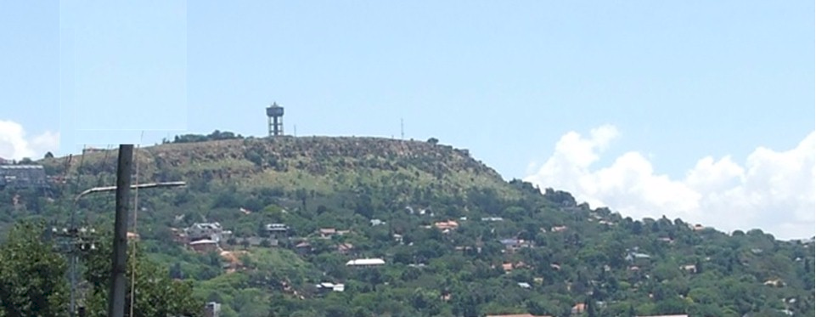
Turning history on its head
Massive evidence of a global flood
What does it all mean?
The End
May Yah the eternally self existing, the Almighty Creator, bless you and keep you and make His face to shine upon you and grant you His peace
Contact me James@ETI-Ministries.org Website www.ETI-Ministries.org
Notes:
May Yah bless you and keep you and make His face to shine upon you and grant you His peace
Roll the text out progressively with the signature tune and close with a crash of thunder?

